Slide 1
Developing Talent
Session 6/10

Slide 2
Session Outline
The strategic importance of learning for organizations and for individuals
Should organizations invest in employee training and development?
The core training system
Employee development

Slide 3
The strategic importance of learning
“Changes are bigger and are happening faster, and learning is the way to keep ahead, to maintain employability in an era when jobs have gone. It enables organizations to sustain their edge as global competition increases. Learning to learn is the ultimately life skill” (Honey, 1998)

Slide 4

The strategic importance of learning

Slide 5
Pressures for learning
Globalization
Organizational
knowledge-based economy
The new career
Individual
The new deal at work

Slide 6
Organizational pressures for learning
Globalization
    Globalization seems to be intensifying the war for talent in developed countries and forcing companies to fight to attract and retain the most skilled workers (Chambers, Foulon, Handfield-Jones, Hankin and Michaels III, 1998).
    Heightened international competition
The knowledge-based economy
  Economic wealth is grounded on “the creation, production, distribution and consumption of knowledge and knowledge-based products” (Harris, 2001:22).
  Economy of software not hardware

Slide 7
Individual pressures for learning
Protean career
“one in which the person, not the organization, is in charge, the core values are freedom and growth, and the main success criteria are subjective (psychological success) vs. objective (position, salary)” (Hall, 2004: 4)
Boundaryless career
A career that moves across the boundaries of different employers. (Arthur, 1994)
People should focus on developing marketable skills rather than firm-specific skills (knowledge is portable)
Employment is “a temporary state, or the current manifestation of long-term employability” (Arthur and Rousseau, 1996: 374)
Workers should not expect to stay with their employers their entire careers.

Slide 8


Key strategic decision:
MAKE or BUY?
In order to have a capable workforce organizations can:
Provide training and development to their workforce
Hire skilled workers by paying attractive salaries

Slide 9

The employability paradox
Do organizations stand to gain from investment in employee training and development?
More competent employees are more productive.
More competente employees can be used in a more flexible way and facilitate adaptation to the environment.

Slide 10

The employability paradox
Do organizations stand to gain from investment in employee training and development?
More competent employees are also more employable and are at higher risk of turnover.
Organizations offering employees training and development opportunities can lose their investment to the competition

Slide 11
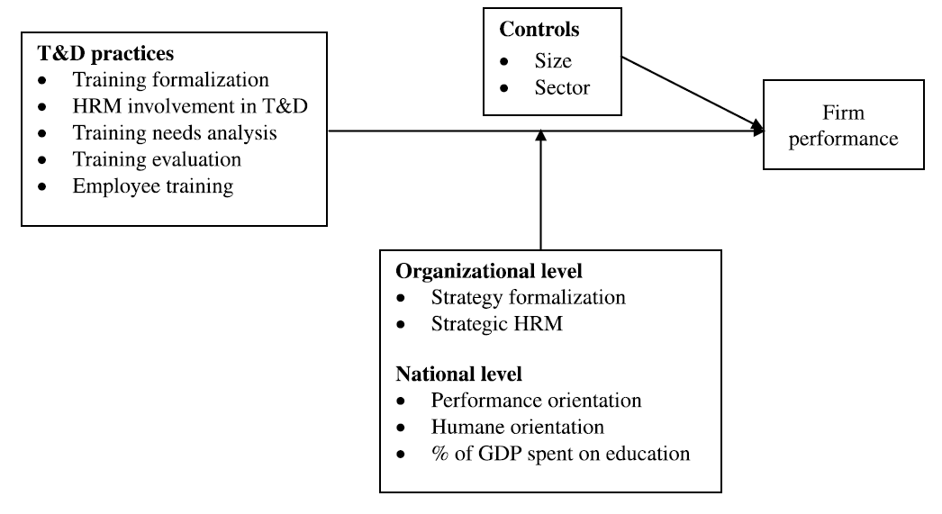
Training & Performance
A correlation has been established between investment in training and performance/employee outcomes
It is difficult to establish causality
    It is not easy/practical to isolate the contribution of training to performance
Source: Nikandrou et al. (2008)

Slide 12
Evaluating the employability paradox
Research shows that employees who feel more employable also report higher intentions to quit their organization (De Cuyper et al., 2011) (their paper does not take into account investment in training and development)
Neliseen et al (2017) found that investment in employee training and development was more strongly associated with internal than with external employability. They didn’t find a link between employability and turnover intentions.

Slide 13
What does our research show?
Evaluating the employability paradox: When does organizational investment in human capital pay off?
Explores some of the circumstances under which investment in career development benefits employees and organizations
  The role of Career Development Practices (training, development, performance management, etc.) - signalling organizational investment in employee career development
  The role of the Protean career – signalling an interest in career development practices
Rodrigues, R., Butler, C. L., & Guest, D. (2020). Evaluating the employability paradox: When does organizational investment in human capital pay off?. The International Journal of Human Resource Management, 31(9), 1134-1156.

Slide 14
What does our research show?
Explores some of the circumstances under which investment in career development benefits employees and organizations
  The role of HRM - signalling organization investment in employee career development
  The role of the Protean career – signalling an interest in career development practices
Career Development Practices T2
Protean Career Orientation T2
H2
H3ab
Perceived External Employability T1
Perceived External Employability T2
H4ab
Intention to Quit T2
Organizational Commitment T2
H1ab

Slide 15
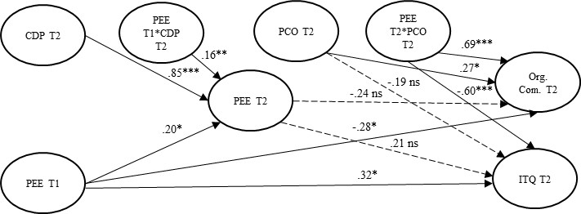
What does our research show?
Significant coefficient
Non-significant coefficient

Slide 16
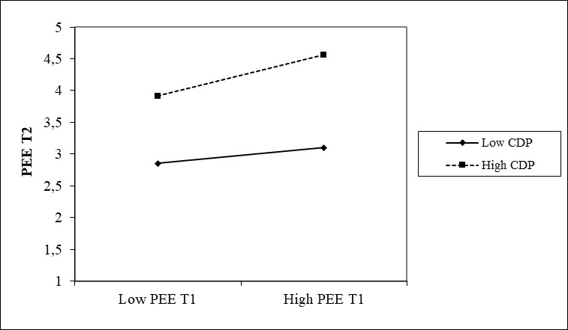
What does our research show?
Investment in Career Development Practices increases people’s perceptions of their own employability in the external market

Slide 17
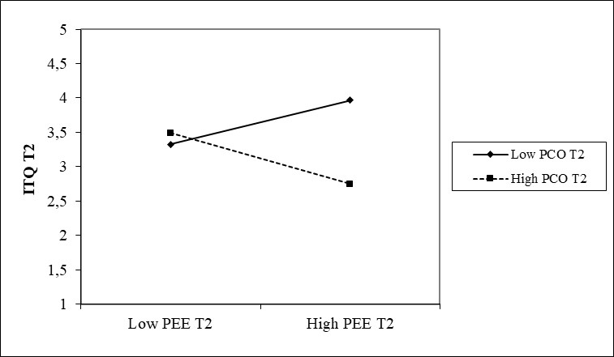
What does our research show?
Higher perceptions of employability are associated with lower intention to quit among individuals who are more proactive in managing their careers (preference to invest in career development in one’s organization?)

Slide 18
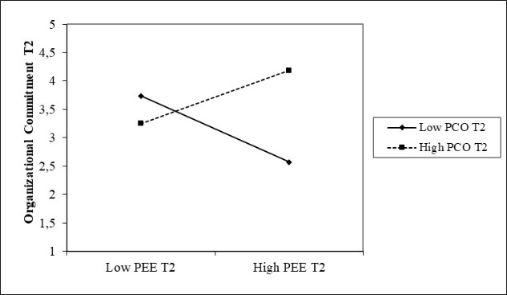
What does our research show?
Higher perceptions of employability are associated with higher organizational commitment among individuals who are more proactive in managing their careers (preference to invest in career development in one’s organization?)

Slide 19
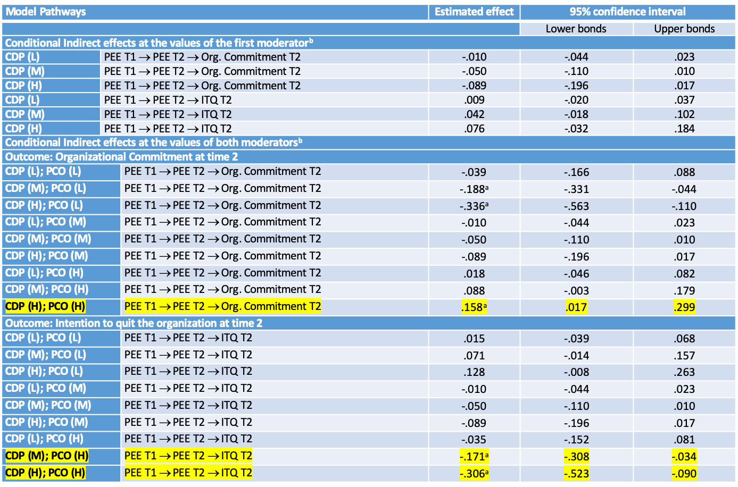
What does our research show?

Slide 20
What does our research show?
In line with previous research our findings show that people who perceive higher employability in the external market (at T1, not at T2) report lower commitment to their organizations and higher intention to quit
When including the role of experienced career development practices and the role the protean career orientation, a rather different picture emerges casting doubt on the employability paradox
  Investment in career development is not associated with a decline in organizational commitment or a rise in intention to quit (norm of reciprocity)
  A high PCO strengthens the positive association between PEE and organizational attachment. This suggests that highly proactive and employable individuals at this early stage of their career mainly seek to progress their career within their current organization
  Organizations benefit from having highly employable individuals only when they invest significantly in career development and employees proactively utilise these practices to manage their own careers

Slide 21
The core training system
Identification of training needs – the gap
Learning aims and objectives
Ensuring employees’ readiness for training
Design training program including content, methods and media
Deliver training
Evaluate training

Slide 22
Identifying training needs
Organizational
Analysis
Training Needs
Task
Analysis
Person
Analysis

Slide 23
Organizational analysis
What is our strategy?
Where do we need to improve?
What will we be doing in the future?

Slide 24
Task analysis
Analyses the tasks performed by employees in terms of:
Difficulty
Frequency with which they are performed
Time spent performing them
Importance and standards of good performance
Skills and abilities required
Make decisions about which tasks/skills/abilities training should focus on

Slide 25
Person analysis
Is training the solution for performance problems?
  Do people have adequate KSA to perform their job?
  Are the resources necessary to perform a task/job available?
  Are there consequences for good and poor performance?
  Are employee’s being given feedback on their performance on a regular basis?
If there is a lack of KSA then training is the solution to improve performance
If all systems and resources are in place (eg. Feedback; performance standards clarity) then training is possibly not the solution

Slide 26
Ensuring Readiness for training
SCENARIO:
As an HR expert you have been asked to investigate why some of the nursing staff at a Primary Care Trust in the London region are not attending mandatory infection control and child protection training. How would you proceed to identify reasons for attendance or non-attendance and what type of measures would you suggest your client implements to improve training attendance?

Slide 27
Training methods
Presentation methods
Hands-on methods

Slide 28
Presentation methods - trainees are passive recipients of information
Classroom instruction
  Typically we have a lecturer transmitting information to one group of trainees
  Inexpensive way to transmit information to many trainees
Distance learning
  Trainees attend programs where they can communicate with the trainer and other trainees at other locations (eg. Videoconferencing)
  Useful for geographically dispersed companies
Audiovisual technique
  Useful for transmitting information and developing skills such as communication, interviewing, and customer-service skills (eg. Training Videos)

Slide 29
Hands-on methods - trainees are actively involved in learning
On-the-job training
  Employees learn through observing peers or managers performing the job and trying to imitate their behavior (adequate for newly hired employees; low skilled workers)
Simulations
  Represents real life situations and allows trainees to see the impact of their decisions in an artificial, risk-free environment (eg. Airplane pilots)
Business games and case studies
  Trainees discuss cases relevant to better understand the complexity of their jobs and engage in games that stimulate acquiring relevant skills and knowledge.
E-learning
  Training content usually delivered via web allowing trainees to have control over the learning process (when, where, at what speed)

Slide 30
Choosing a method
Who is it for?
  Methods such as on-the-job training may be more useful to train unskilled workers than managers
What is it for?
  Classroom training may be more adequate to transmit information on labor law than case studies or simulations.
What is the cost?
  Audiovisual techniques may be less expensive to transmit company policy on customer care to thousands of workers dispersed across a country than classroom training. However, if we are training a few dozen workers producing a video may be too expensive.

Slide 31
Evaluate training
Outcomes | Description | How to evaluate?
Cognitive Outcomes | Evaluates what trainees have learned in the program (principles, facts, etc.) | Paper and pencil tests
Skill-based outcomes | Evaluates the skills (motor skills; behaviors) trainees have acquired in the program | Observation Simulations
Affective Outcomes | Evaluates the attitudes and motivations (including reaction to training) trainees have developed in the program | Interviews Focus groups Questionnaires
Results | Evaluates the training’s payoff for the company (reduced defective parts; reduced turnover, etc.) | Observation Performance data analysis
ROI | Evaluates the economic benefits of training | Relates the costs with the benefits of training

Slide 32
Employee development:
Beyond current job requirements

Slide 33
Approaches to Employee Development
Formal education
  National Vocational Training and Education
  Executive education initiatives
Assessment
  Psychological assessment (e.g., Myers-Briggs test)
  Assessment centers
  Benchmarks
  Performance appraisals
  360-Degree Feedback Systems

Slide 34
Approaches to Employee Development
Job experiences
  Promotion
  Lateral move
  Demotion
Interpersonal relationships
  Mentoring
  Coaching

Slide 35
Formal education
(Executive training)
Formal education programs include a number of programs designed specifically for the company’s employees:
Short courses offered by consultants or universities
Executive MBA programs (distance learning programs are becoming very popular)
Customized short courses with content designed to meet the needs of one specific organization.
Fast-track managerial programs – targeted at high-potential organizational workers

Slide 36
Assessment Centers
At an assessment center, multiple raters evaluate employees’ skills (leadership, oral and written communication, judgment, organizational ability, and stress tolerance) and performance on a number of exercises.
Types of exercises include:
  Leaderless group discussion - a team of 5/7 employees is assigned a problem and must work together to solve it within a certain time period.
  Interviews - about their work and personal experiences, skill strengths and weaknesses, and career plans
  In-baskets - It’s a simulation of the administrative tasks on a manager’s desk
  Role plays - the participant taking the part or role of a manager or another employee.

Slide 37
Feedback systems
Feedback systems, particularly performance appraisal, can be very useful for employee development, particularly if it involves a discussion on how employees can improve their performance and a plan on how to attain future goals (skill development, behaviour modification, etc.)
360-degree feedback can be particularly useful as employees receive evaluations from a wide range of persons with whom they interact with (peers, supervisors, clients, etc.).

Slide 38
Employee Development Experiences
Promotion
Enlargement of
current job
experiences
Job rotation
Transfer
Temporary
assignments with
another organization
Downward Move
Source: Noe et al., 2004

Slide 39
Employee Development Experiences
Job enlargement - Adding new tasks and responsibilities to an employee’s current job.
Job rotation - Moving a single individual from one job to another to perform a new set of tasks and have new responsibilities
A transfer - Movement of an employee to a different job assignment in a different area of the company (may involve a new geographical location)
Promotions – Advancing to a new hierarchical position within an organization.
A downward move – Moving downwards in the hierarchical structure of the organization (developmental when people are making significant career transitions. E.g. from pharmacist to manager)

Slide 40
Interpersonal relationships - Mentoring
A mentor is an experienced senior employee who helps develop a less experienced employee
Benefits:
Socialization of new employees;
Increases the likelihood of skill transfer from training to the work setting;
Career opportunities;
Exposure of new talent to senior employees.

Slide 41
Interpersonal relationships - Coaching
Coaching
A coach is a peer or manager who works with an employee to motivate him, help him develop skills, and provide reinforcement and feedback.
Benefits:
  Feedback from more experienced workers
  Employees have the opportunity to learn for themselves
  Employees may be offered career development resources such as training and new job experiences they would not have access to without a coach

Slide 42
References
Arthur, M. B. (1994). The boundaryless career: A new perspective for organizational inquiry. Journal of organizational behavior.
Boyatzis. R. (1982). The competent manager: A model for effective performance. John Wiley & Sons.
Chambers, E. G., Foulon, M., Handfield-Jones, H., Hankin, S. M., & Michaels, E. G. (1998). The war for talent. McKinsey Quarterly, 44-57.
Hall, D. T. (2004). The protean career: A quarter-century journey. Journal of vocational behavior, 65(1), 1-13.
Harris, R. G. (2000). The Knowledge-based Economy: Facts and Theories. Queen's School of Business, Centre for Knowledge-Based Enterprises.
Honey, P. (1999) A declaration on learning, Human Resource Development International, 2:1, 9-16.
MacDuffie, J. P., & Kochan, T. A. (1995). Do US firms invest less in human resources?: training in the world auto industry. Industrial Relations: A Journal of Economy and Society, 34(2), 147-168.
Nikandrou, I., Apospori, E., Panayotopoulou, L., Stavrou, E. & Papalexandris, N. (2008), Training and firm performance in Europe: the impact of national and organizational characteristics. The International Journal of Human Resource Management, 19(11): 2057-2078.
Ribeaux, P., & Poppleton, S. E. (1978). Psychology and Work: an introduction. Macmillan.
Rodrigues, R., Butler, C. L., & Guest, D. (2020). Evaluating the employability paradox: When does organizational investment in human capital pay off?. The International Journal of Human Resource Management, 31(9), 1134-1156.

